Slide 1
Movie Ticket Booking System
Presented by:Subarna Shri Devi R

Slide 2
Title Slide
Title: Movie Ticket Booking System
Subtitle: Explanation of the program using SQL,TKinter and Python

Slide 3
Agenda
Intoduction to the project
SQL Database Design
Python code breakdown
Tkinter GUI Design
System Flow
Program Execution and Output

Slide 4
Introduction
Overview of the Movie Ticket Booking System
Purpose: Allows users to book movie tickets online.
Technology Used:
Backend:SQL (MySQL for database management)
Frontend: Tkinter (for GUI)
Programming Language: Python

Slide 5
Database Design (Overview)
Entities:
Users
Movies
Theaters
Shows
Bookings
Relationships:
Users can book tickets for shows
Shows are specific to movies and theaters

Slide 6
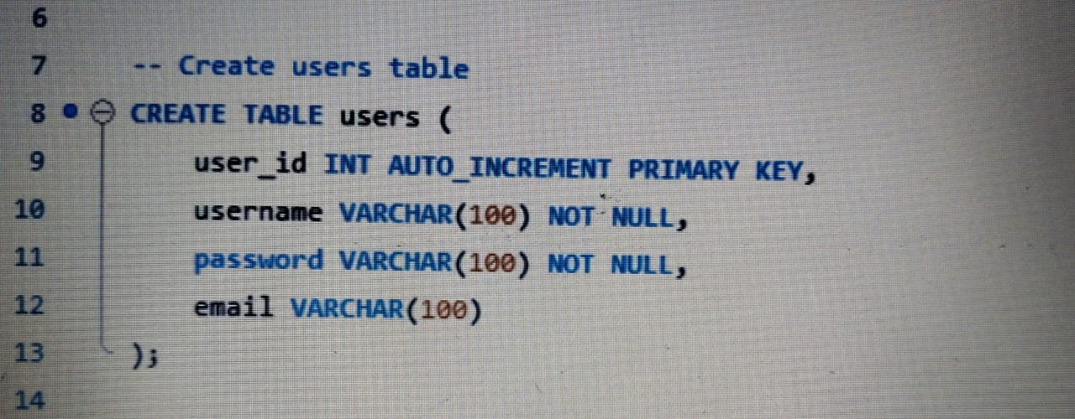
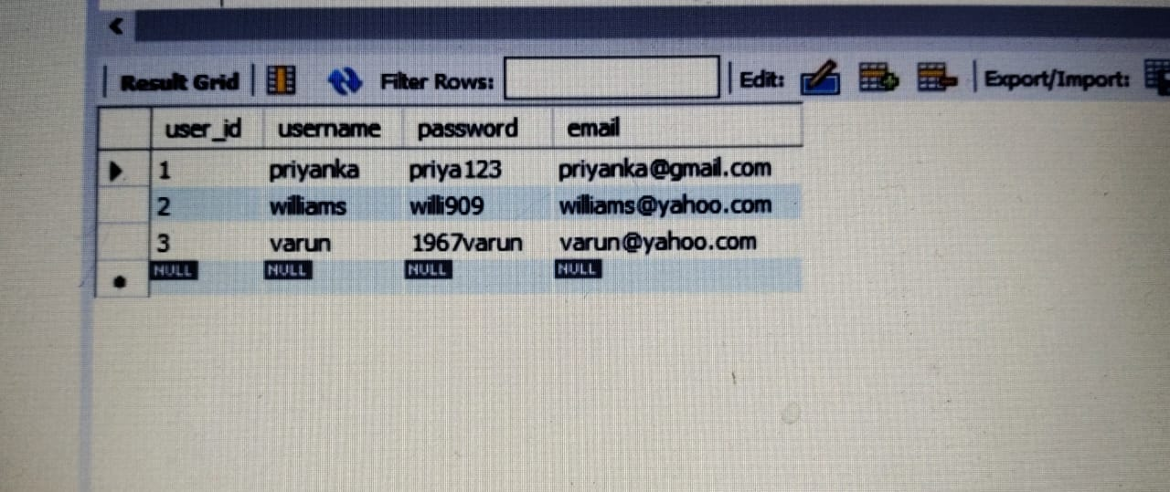
SQL: Users Table
Purpose: Stores user information (username, password, and email).
Key Fields:
* user_id (Primary Key)
* username (Unique)
* password
* email
Result

Slide 7
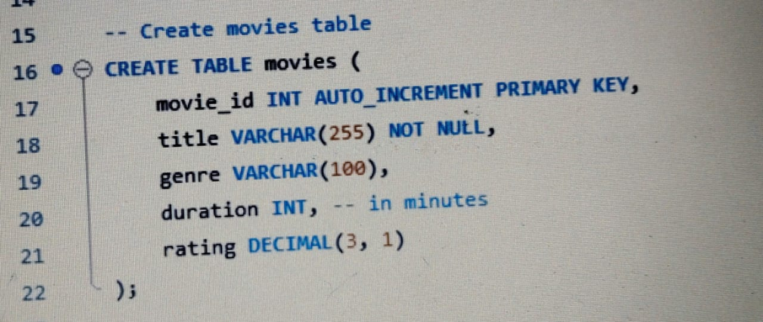
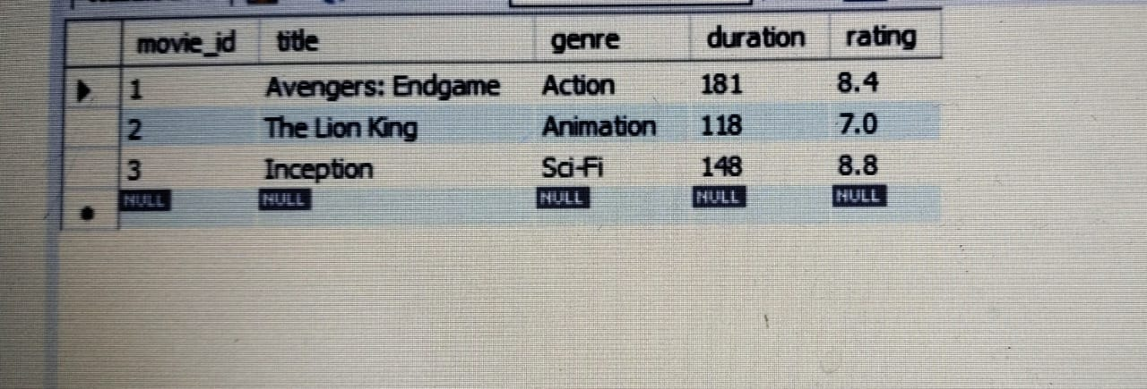
SQL: Movies Table
Purpose: Stores movie details.
Key Fields:
- movie_id (Primary Key)
- title (Movie name)
- genre (Genre of the movie)
- duration (Duration in minutes)
- rating (Movie rating)
Result

Slide 8
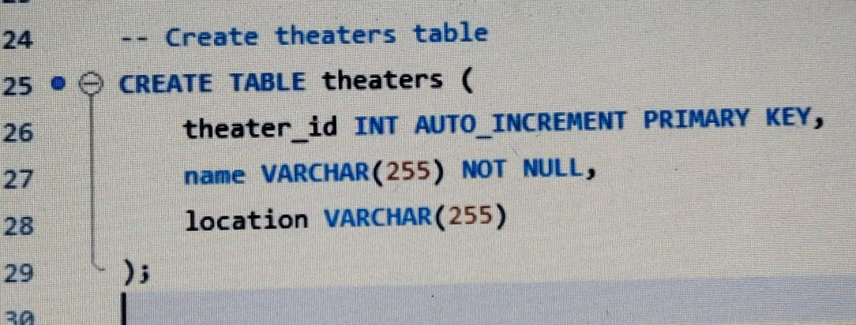
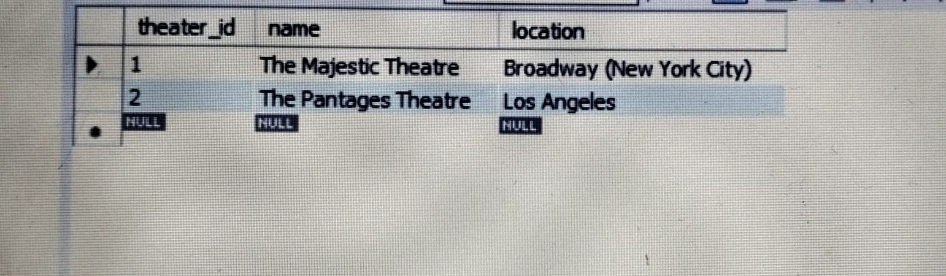
SQL: Theaters Table
Purpose: Stores theater details.
Key Fields:
- theater_id (Primary Key)
- name (Theater name)
- location (Theater address)
Result

Slide 9
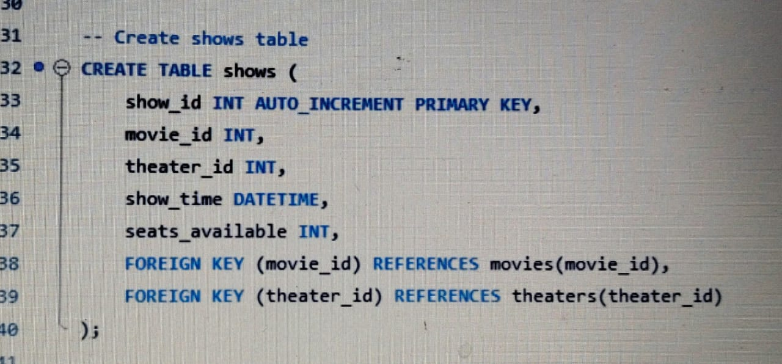
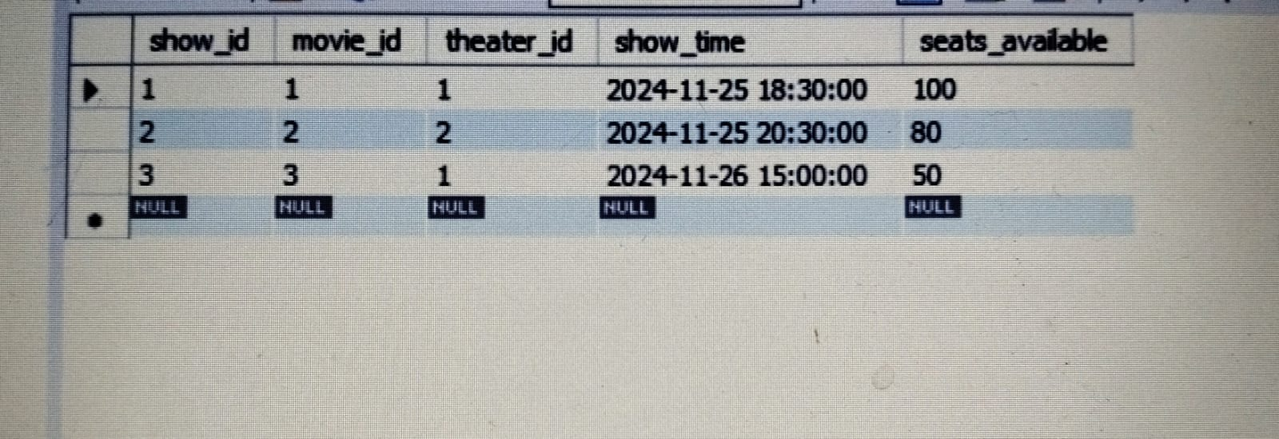
SQL: Shows Table
Purpose: Stores show details for each movie in a theater.
Key Fields:
- show_id (Primary Key)
- movie_id (Foreign Key from movies table)
- theater_id (Foreign Key from theaters table)
- show_time (Showtime of the movie)
- seats_available (Seats remaining for the show)
Result

Slide 10
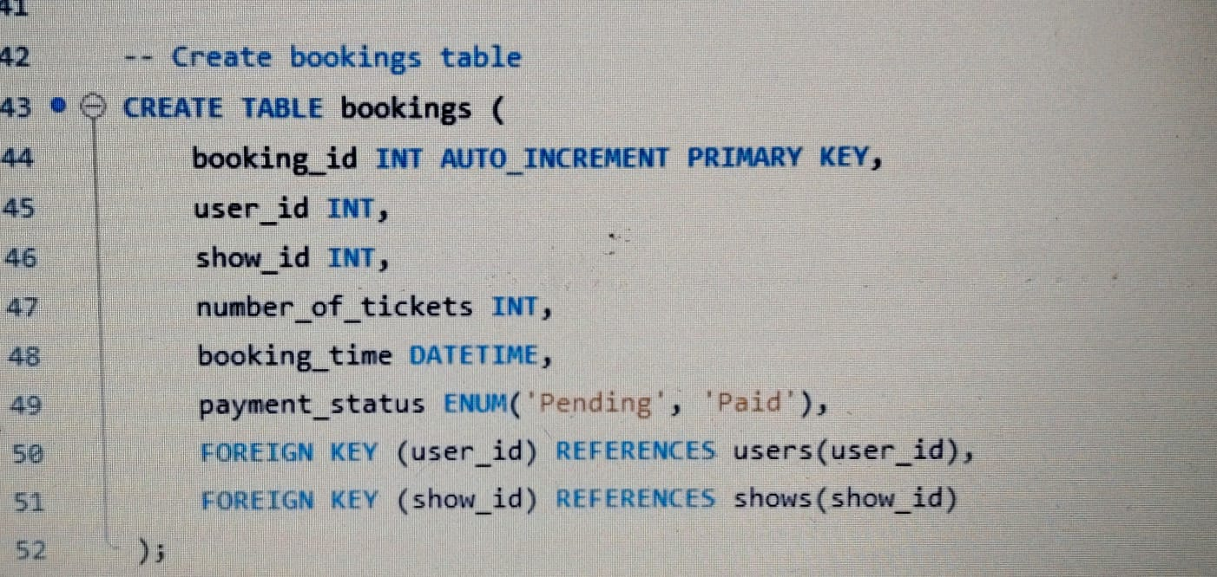
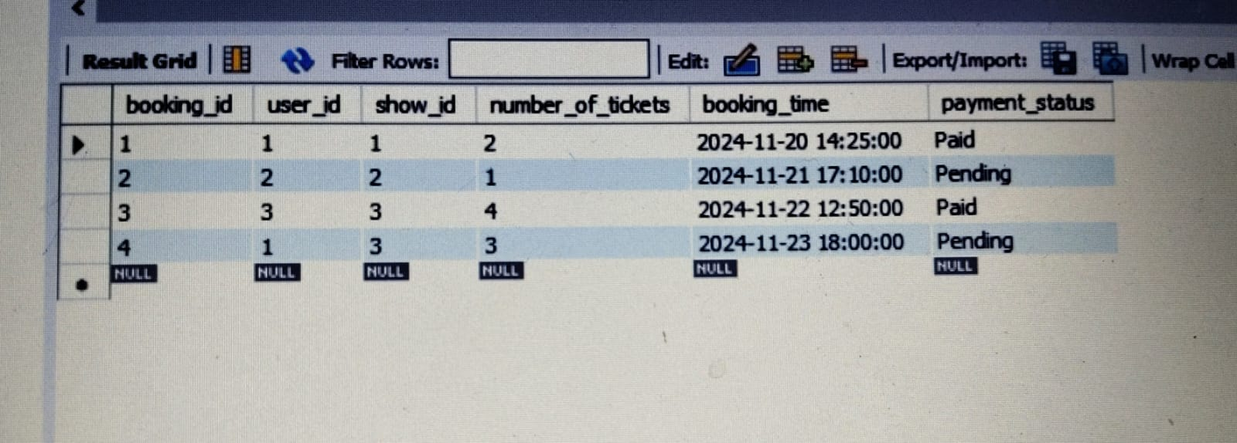
SQL: Bookings Table
Purpose: Stores booking details.
Key Fields:
- booking_id (Primary Key)
- user_id (Foreign Key from users table)
- show_id (Foreign Key from shows table)
- number_of_tickets (Tickets booked)
- payment_status (Pending or Paid)
Result

Slide 11
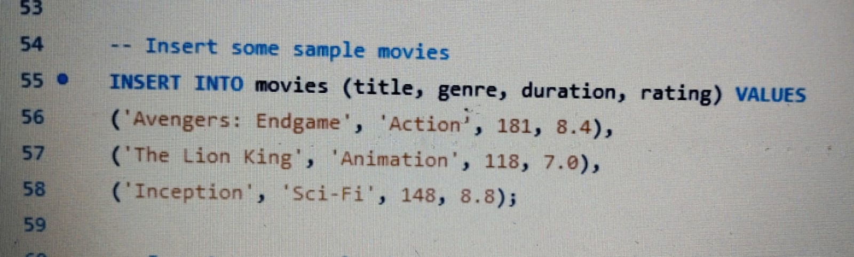
Sample Data Insertions (Movies)
- Sample movie data.
- Each movie includes title, genre, duration, and rating.

Slide 12
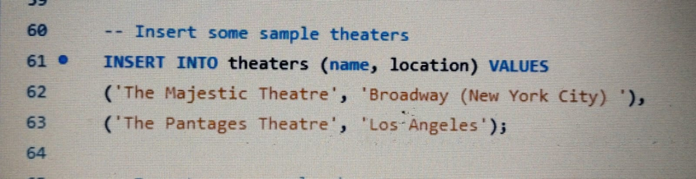
Sample Data Insertions (Theaters)
- Sample theater data.
- Includes theater name and location.

Slide 13
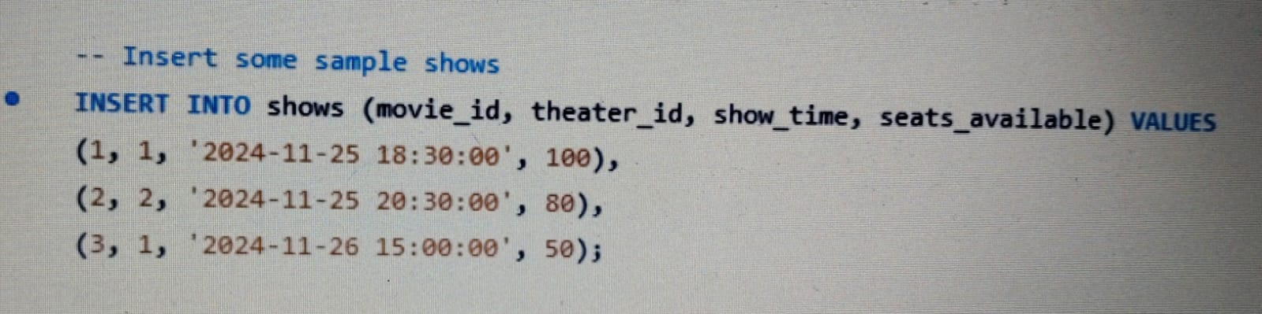
Sample Data Insertions (Shows)
Sample show data for each movie in theaters with available seats.

Slide 14
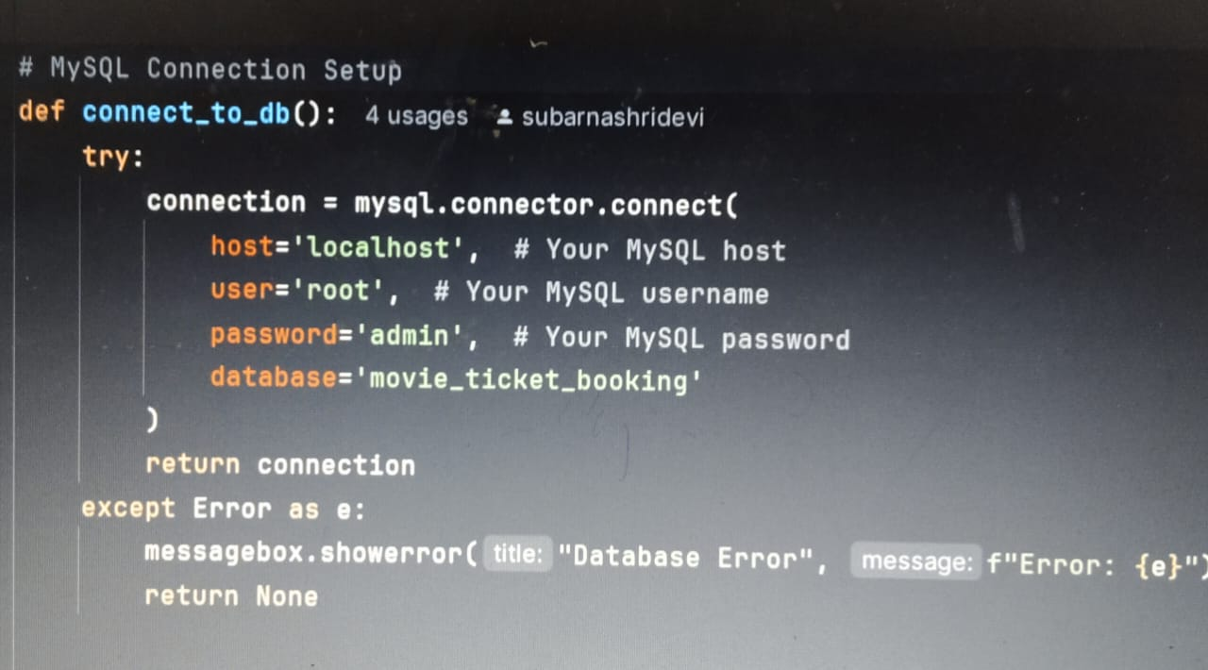
Python: MySQL Connection Setup python
Purpose: Establish a connection to the MySQL database.

Slide 15
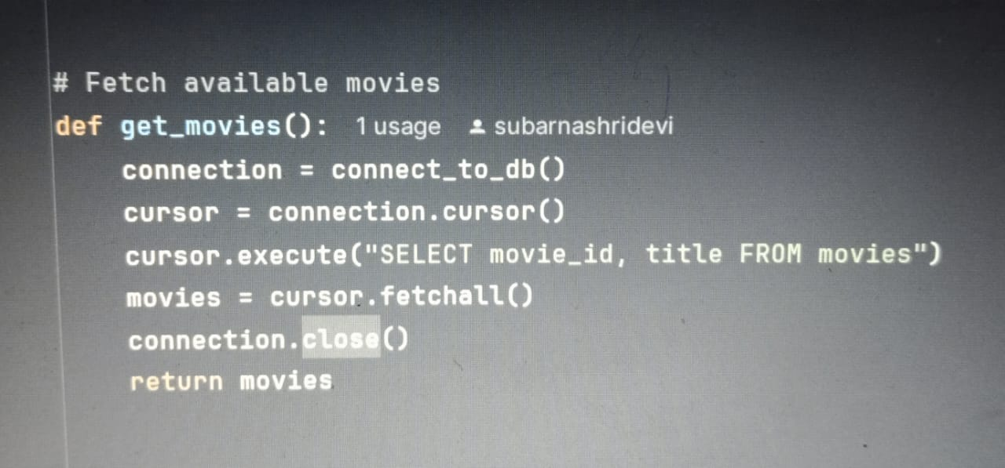
Fetching Movies in Python
Purpose: Fetch list of movies from the database.

Slide 16
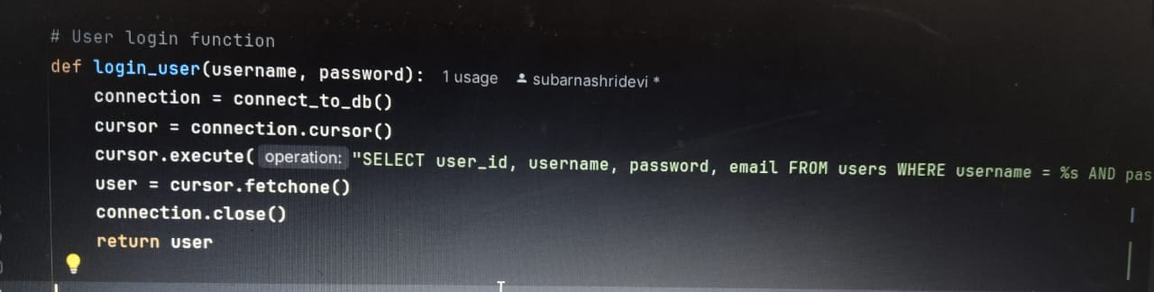
Login Function in Python
Purpose: Validate user login credentials.

Slide 17
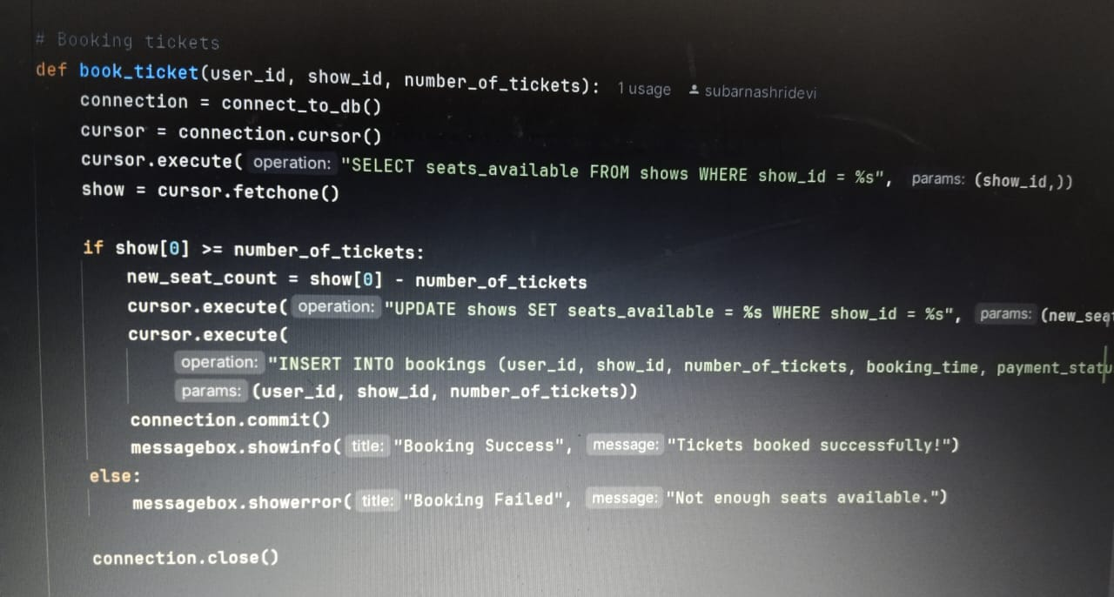
Booking Function in Python
Purpose: Handles ticket booking, updates seats, and stores booking details.

Slide 18
Tkinter GUI: Main Class Structure
Purpose: The main GUI class (MovieTicketBookingApp) manages the user interface.
- Login
- Movie selection
- Show selection
- Ticket booking

Slide 19
GUI Flow
Login Window: Users enter credentials.
- Movie Selection: Shows available movies.
- Show Selection: Select a show based on the chosen movie.
- Ticket Booking: Enter the number of tickets and complete the booking.

Slide 20
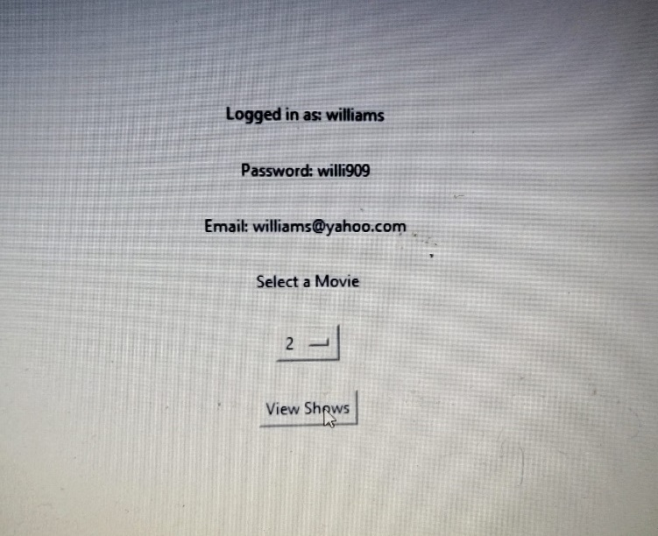
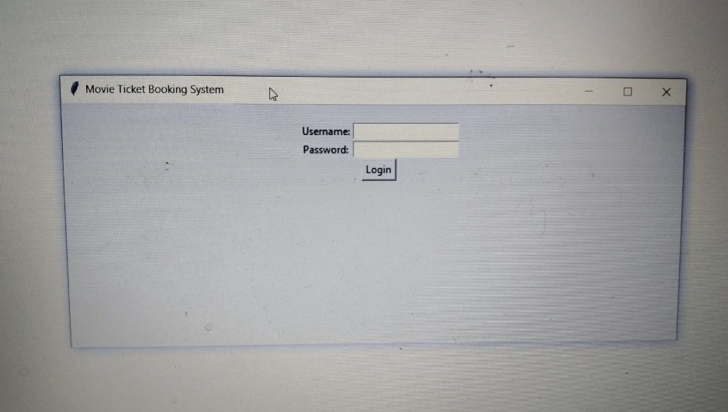
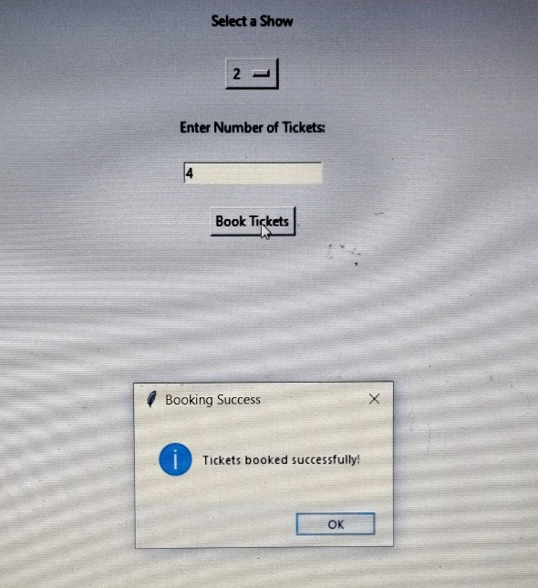
Program Output
Login Page
After entering username & password ,select a movie and view shows
If the shows available then the Ticket is booked Successfully

Slide 21
Conclusion
Summary:
- A user-friendly movie ticket booking system.
- Efficient database management using SQL.
- Interactive GUI with Tkinter for easy ticket booking.
Future Improvements:
- Payment gateway integration.
- Enhanced user interface design.

